Slide 1
Keeping a Crowd Safe On the Complexity of Parameterized Verification
Javier Esparza
Technical University of Munich

Slide 2
Wilfried Brauer (1937-2014)
Book of condolence:
http://kondolenz.informatik.tu-muenchen.de

Slide 4
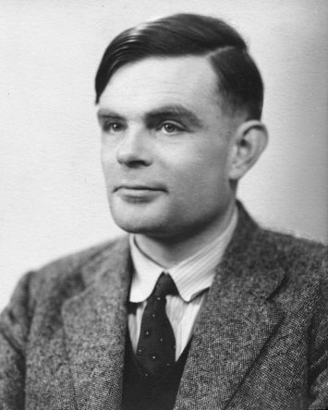
„Why don´t you give up?“
Theorem (Alan Turing, 1936)
Program termination is undecidable.
Theorem (Henry G. Rice, 1961)
Every non-trivial property of programs is undecidable.
Theorem (Marvin Minsky, 1969)
Every non-trivial property of while-programs with two counter variables is undecidable.

Slide 5
„Why don´t you give up?“
Theorem (Alan Turing, 1936)
Program termination is undecidable.
Theorem (Henry G. Rice, 1961)
Every non-trivial property of programs is undecidable.
Theorem (Marvin Minsky, 1969)
Every non-trivial property of while-programs with two counter variables is undecidable.

Slide 6
„Why don´t you give up?“
Theorem (Alan Turing, 1936)
Program termination is undecidable.
Theorem (Henry G. Rice, 1961)
Every non-trivial property of programs is undecidable.
Theorem (Marvin Minsky, 1969)
Every non-trivial property of while-programs with two counter variables is undecidable.

Slide 7
Because …
Undecidability requires some source of „infinity“:
Variables with an infinite range
Dynamic data structures (lists, trees)
Unbounded recursion
Concurrent systems
are difficult to get right, and
often have a finite state space.

Slide 8
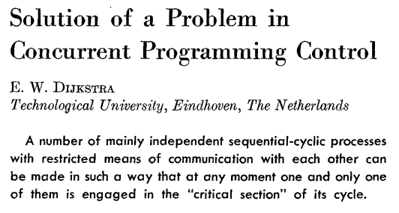
Dijkstra´s Mutual Exclusion Algorithm
CC
CACM 8:9, 1965

Slide 9
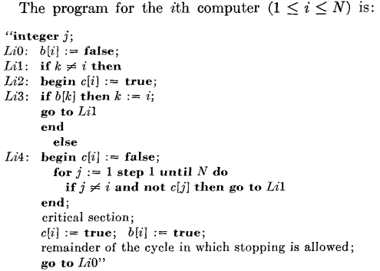
Concurrent programs are often finite-state
CC

Slide 10
Concurrent programs are often finite-state
CC
Only two boolean variables per process!

Slide 11
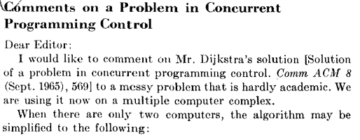
Concurrent programs are difficult to get right
CC
CACM 9:1, 1966

Slide 12
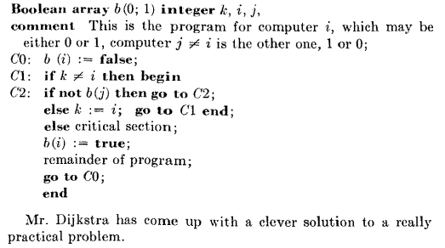
Concurrent programs are difficult to get right
CC

Slide 13
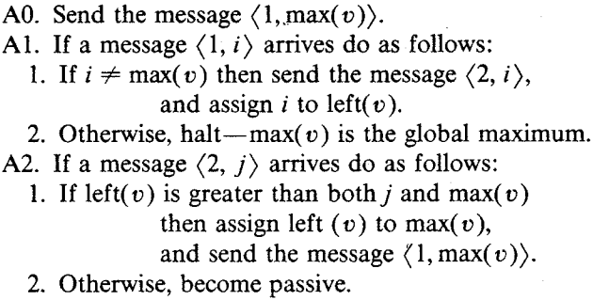
A Leader Election Algorithm (90s)

Slide 14
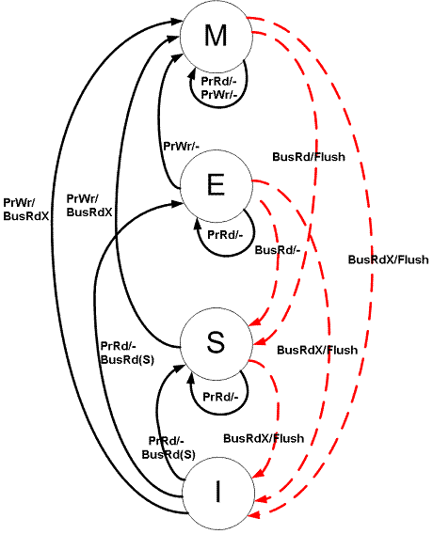
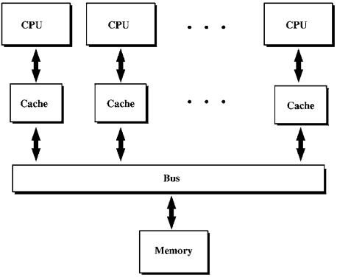
A Cache-Coherence Protocol (00s)
Murphi
model checker
(Dill et al.)
Source: Wikipedia

Slide 15
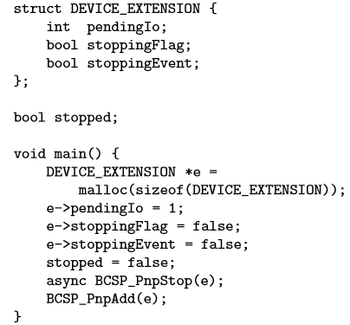
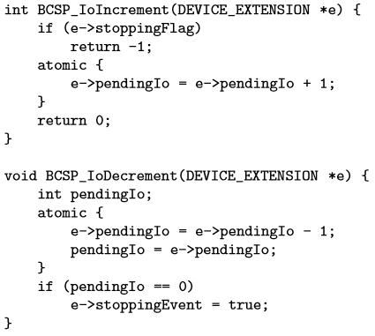
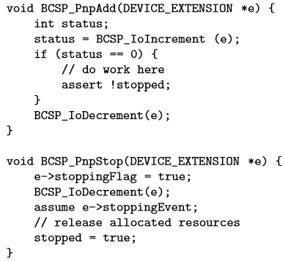
A Model of a Bluetooth Driver (10s)
KISS
(Qadeer and Wu)

Slide 16
Parameterized Verification
Model-checking tools can only check instances of these systems for particular values of the number N of processes.
Can we prove correctness for every N ?
Amounts to checking an infinite family of finite-state systems.

Slide 17
Parameterized Verification
Model-checking tools can only check instances of these systems for particular values of the number N of processes.
Can we prove correctness for every N ?
Amounts to checking an infinite family of finite-state systems.

Slide 18
Keeping a Crowd Safe
The coverability problem:
Given: a program template $T[i]$ with finite-range variables,
a „dangerous“ control point $ℓ$ of $T[i]$.
Decide: Is there a number $N$ such that the crowd
$$T\left[1\right]∥T[2]∥⋯∥T[N]$$
can reach a global state in which at least one of $T\left[1\right],T\left[2\right],…,T[N]$ is at $ℓ$ ?

Slide 19
Parameterized Verification: Give up?
Theorem (folklore): The Halting Problem can be reduced to the parameterized coverability problem.
Reduction:
The template models the behaviour of one tape cell.
TM terminates
$→$ it uses a finite number N of cells
$→$ N copies of the template reach the dangerous state

Slide 20
Parameterized Verification: Give up?
Theorem (folklore): The Halting Problem can be reduced to the parameterized coverability problem.

Slide 21
Parameterized Verification: Give up?
Theorem (folklore): The Halting Problem can be reduced to the parameterized coverability problem.
Parameterized verification is doomed!

Slide 22
Identities
In this reduction processes do not execute exactly the same code
The code makes use of the process identity (the index $i$) to organize processes in an array.
But many systems do not use identities:
DKR Leader Election uses identities.
Dijkstra´s algorithm, MESI-protocol, and Bluetooth driver do not.
In others, processes must remain anonymous!

Slide 23
Anonymous Crowds
We investigate the decidability and complexity of the coverability problem for crowds in which
every process executes exactly the same code, (anonymous crowds), and
the number of processes is unknown to the processes.

Slide 24
Keeping an Anonymous Crowd Safe
The coverability problem for anonymous crowds (TCS version) :
Given: a finite automaton $A$ and a „dangerous“ state $ℓ$ of $A$.
Decide: Is there a number $N$ such that the anonymous crowd
$$\underset{N copies}{\underbrace{ A∥A∥⋯∥A}}$$
can reach a global state in which at least one of the $N$ copies is at $ℓ$ ?

Slide 25
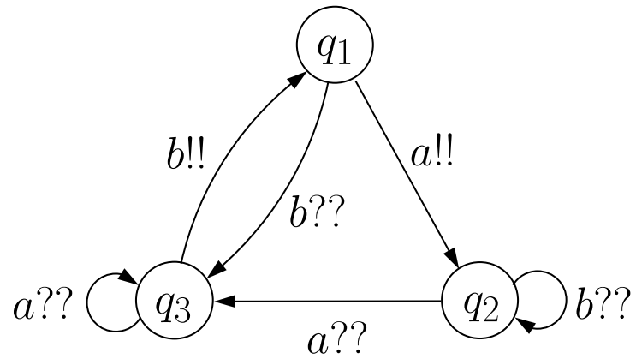
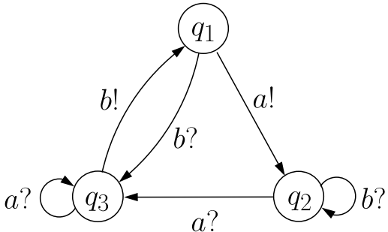
Communication Mechanisms
Reliable broadcast
A process sends a message
All other processes receive the message (instantaneously)
Rendez-vous
Synchronous exchange of a message between two processes

Slide 26
Communication Mechanisms
Reliable broadcast
A process sends a message
All other processes receive the message (instantaneously)
Rendez-vous
Synchronous exchange of a message between two processes

Slide 27
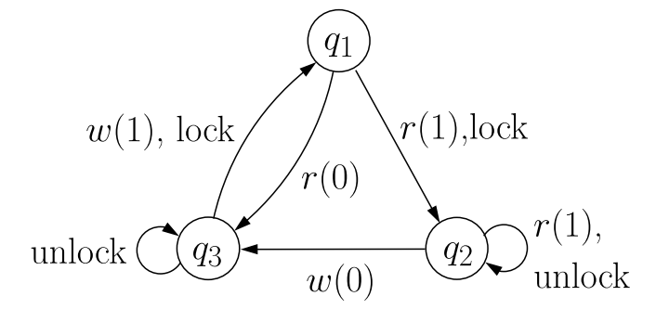
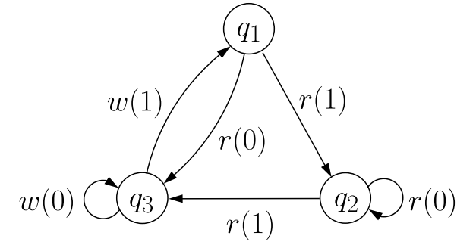
Communication Mechanisms
Shared memory with locking
Processes compete for a lock
Process owning the lock can perform reads and writes
Shared memory, no locking
Concurrent reads and writes allowed
Interleaving semantics

Slide 28
Communication Mechanisms
Shared memory with locking
Processes compete for a lock
Process owning the lock can perform reads and writes
Shared memory, no locking
Concurrent reads and writes allowed
Interleaving semantics

Slide 29
High or Low Complexity?
Verifiers want low complexity

Slide 30
High or Low Complexity?
Verifiers want low complexity
„Crowd designers“ (swarm intelligence, population protocols, crowdsourcing) want high complexity

Slide 31
Reliable broadcast
Theorem [E., Finkel, Mayr 99] The coverability problem for broadcast protocols is decidable.
Informally:
Anonymous crowds are not Turing powerful
Straightforward application of the backwards reachability algorithm by Abdulla et al., based on the theory of well-quasi-orders.

Slide 32
Reliable broadcast
A configuration of the system is completely determined by the number of processes in each state. (No identities)
Symbolic Backward Search
$C≔D$ /* $D$angerous */
Iterate $C≔C∪pre(C)$ until
$C∩Init≠∅$; return „unsafe“
or
$C$fixpoint; return „safe“

Slide 33
Reliable broadcast
A configuration of the system is completely determined by the number of processes in each state. (No identities)
Symbolic Backward Search
$C≔D$ /* $D$angerous */
Iterate $C≔C∪pre(C)$ until
$C∩Init≠∅$; return „unsafe“
or
$C$fixpoint; return „safe“
Problems:
$C$ contains infinite sets. Finite representation?
Termination?

Slide 34
Reliable broadcast
Partial order on configurations:
$c≤c^{′}$ if $c′$ has at least as many processes as $c$ in each state
$≤$“ is a well-quasi-order : a well-founded partial order with no infinite antichains.
Consequence: $C$ always has finitely many minimal elements.
Finite representation
Termination

Slide 35
Reliable broadcast
Partial order on configurations:
$c≤c^{′}$ if $c′$ has at least as many processes as $c$ in each state
$≤$“ is a well-quasi-order : a well-founded partial order with no infinite antichains.
Consequence: $C$ always has finitely many minimal elements.
Finite representation
Termination
Love it!

Slide 36
Reliable broadcast: Complexity
Theorem (Schmitz and Schnoebelen 13)
The coverability problem for broadcast protocols has non-primitive-recursive complexity.

Slide 37
Reliable broadcast: Complexity
Theorem (Schmitz and Schnoebelen 2013)
The coverability problem for broadcast protocols has non-primitive-recursive complexity.

Slide 38
Reliable broadcast: Complexity
Theorem (Schmitz and Schnoebelen 13)
The coverability problem for broadcast protocols has non-primitive-recursive complexity.
Put that in your pipe and smoke it, Sherlock!

Slide 39
Reliable broadcast: Complexity
Theorem (Schmitz and Schnoebelen 13)
The coverability problem for broadcast protocols has non-primitive-recursive complexity.
Don‘t despair, Sherlock!
Backwards reachability is useful for verification! I‘ve used it to prove properties of a dozen cache-coherence protocols: their templates have under 10 states!
G. Delzanno

Slide 40
Shared memory with locking
Two essential properties of reliable broadcast:
Everybody receives every message
The crowd can produce a leader
Shared memory with locking
Can still produce a leader
Can only guarantee that somebody receives a message

Slide 41
Shared memory with locking
Theorem:
The coverability problem for systems communicating through a global store with locking is EXSPACE-complete.

Slide 42
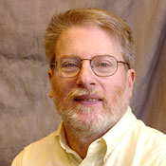
Shared memory with locking
Lower bound
[Lipton 1976]
A template with $O\left(n^{2}\right)$ states can simulate a counter counting up to $2^{2^{n}}$.

Slide 43
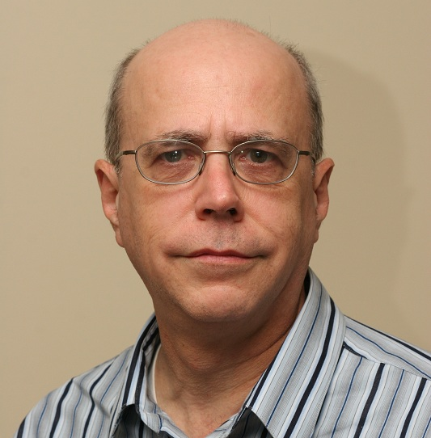
Shared memory with locking
Lower bound
[Lipton 1976]
Upper bound [Rackoff 1978]:
If the goal state is coverable, then it is coverable in an instance with ${2^{2}}^{O(n)}$ processes.

Slide 44
Shared memory with locking
Upper bound [Rackoff 1978]:
Unfortunately, for us verifiers this upper bound is algorithmically useless …

Slide 45
Shared memory with locking
Theorem [Bozzelli, Ganty 2012]: Symbolic backwards reachability runs in double exponential time for global store with locking.

Slide 46
Shared memory with locking
Love it!
But backwards algorithms often generate too many unreachable states! Cant´t you come up with a forward exploration algorithm?
Theorem [Bozzelli, Ganty 2012]: Symbolic backwards reachability runs in double exponential time for global store with locking.

Slide 47
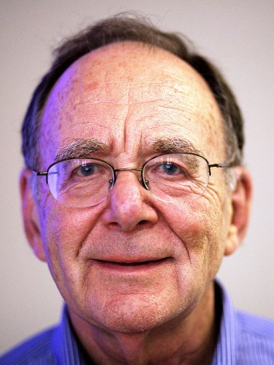
Shared memory with locking
The Karp-Miller coverability graph (1969).
Configuration: $\left(5, 0, 1 \right| 4)$
Generalized configuration: $\left(ω, 3, 2 \right| 4)$
where $ω$ stands for „arbitrarily many“
Initially: $\left(ω, 0,…, 0\right| v_{0})$
Construct a „forward reachability graph“:
If $q_{1}\underset{→}{w(3)} q_{3}$ then $\left(ω, 1, 2 \right| 5)→\left(ω, 1, 3 \right| 3)$
Problem: termination

Slide 48
Shared memory with locking
„Accelerate“ the construction:
Change $\left(ω, 1, 1, 0 \right| 5)→⋯→\left(ω,2, 1,3 \right| 5)$
to $\left(ω, 1, 1,0 \right| 5)→⋯→\left(ω,ω,1,ω \right| 5)$
Theorem: The Karp-Miller graph is always finite.

Slide 49
Shared memory with locking
„Accelerate“ the construction:
Change $\left(ω, 1, 1, 0 \right| 5)→⋯→\left(ω,2, 1,3 \right| 5)$
to $\left(ω, 1, 1,0 \right| 5)→⋯→\left(ω,ω,1,ω \right| 5)$
Theorem: The Karp-Miller graph is always finite.
But: The Karp-Miller graph can have non-primitive recursive size.

Slide 50
Shared memory with locking
„Accelerate“ the construction:
Change $\left(ω, 1, 1, 0 \right| 5)→⋯→\left(ω,2, 1,3 \right| 5)$
to $\left(ω, 1, 1,0 \right| 5)→⋯→\left(ω,ω,1,ω \right| 5)$
Theorem: The Karp-Miller graph is always finite.
But: The Karp-Miller graph can have non-primitive recursive size.
Don´t love it!

Slide 51
Shared memory with locking
Expand, Enlarge, Check [Geeraerts et al. 2004]
The Karp-Miller acceleration is „exact“: It only introduces an $ω$ when it is safe to do so.
Construct instead a sequence of „overapproximations“ : the $i$-th overapproximation identifies „more than $i$processes“ with „arbitrarily many“.
Theorem [Majumdar, Zhang 13]: The EEC algorithm solves coverability in double exponential time.

Slide 52
Shared memory with locking
Expand, Enlarge, Check [Geeraerts et al. 2004]
The Karp-Miller acceleration is „exact“: It only introduces an $ω$ when it is safe to do so
Construct instead a sequence of „overapproximations“ : the $i$-th overapproximation identifies „more than $i$processes“ with „arbitrarily many“.
Theorem [Majumdar, Zhang 2013]: The EEC algorithm solves coverability in double exponential time.

Slide 53
Rendez-Vous
Recall: Shared memory with locking
can produce a leader, and
guarantees that somebody receives a message
The rendez-vous mechanism
guarantees that somebody receives a message, but
cannot produce a leader

Slide 54
Rendez-Vous
Theorem [folklore?, E. 2014]
The coverability problem for systems communicating by rendez-vous and having a symmetric initial configuration is polynomial.
Main intuition: The nodes of the Karp-Miller graph are vectors whose components are either $ω$ or 0.

Slide 55
Shared memory without locking
Theorem
The coverability problem for systems communicating by rendez-vous whose initial configuration has a leader is EXPSPACE-complete.

Slide 56
Shared memory, no locking
Locking is difficult to implement and potentially dangerous for many networked systems with dynamic membership
Vehicular networks
Ad-hoc networks

Slide 57
Shared memory, no locking
Recall: The rendez-vous mechanism
guarantees that somebody receives a message, but
cannot produce a leader
Shared memory without locking
cannot produce a leader and
cannot guarantee that somebody receives a message (overwrites)

Slide 58
Shared memory, no locking
Theorem [E.,Ganty, Majumdar 2013, E. 2014]
The coverability problem for shared memory without locking and a symmetric initial configuration is polynomial.
If the initial configuration has a leader then the problem is NP-complete.

Slide 59
Shared memory, no locking
Theorem [E.,Ganty, Majumdar 2013, E. 2014]
The coverability problem for shared memory without locking and a symmetric initial configuration is polynomial.
If the initial configuration has a leader then the problem is NP-complete.
Love it!
Piece of cake for our SMT-solvers …

Slide 60
Shared memory without locking
Theorem [E.,Ganty, Majumdar 2013]
The problem remains NP-complete if the template is a polytime Turing machine

Slide 61
Shared memory without locking
Theorem [E.,Ganty, Majumdar 2013]
The problem remains NP-complete if the template is a polytime Turing machine
Not good!
This means we cannot distribute an exponentially long computation onto exponentially many machines so that each machine only does polynomial work.

Slide 62
Summary
 | Leader | No leader
Everybody listens | Broadcast Non-primitive recursive
Somebody listens | ShM, Locks EXPSPACE-complete | Rendez-vous Polynomial/ EXSPACE-complete
No guarantee |  | ShM, no locks Polynomial/ NP-complete

Slide 63
Further work and open questions
Termination

Slide 64
Further work and open questions
Termination
Temporal logics

Slide 65
Further work and open questions
Termination
Temporal logics
Implementations

Slide 66
Further work and open questions
And if the processes know N?
Termination
Temporal logics
Implementations

Slide 67
That´s all!

Slide 68
Shared memory with locking
Are you ever happy?
Theorem [Bozzelli, Ganty 12]: Symbolic backwards reachability runs in double exponential time for global store with locking.

Slide 69
A Carry-Look-Ahead 4-Bit-Adder

Slide 70
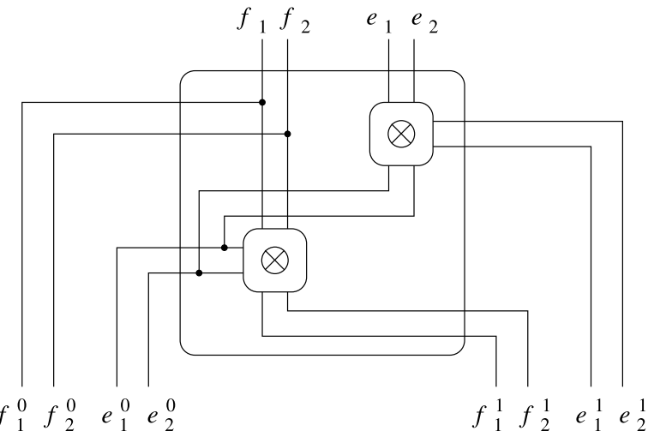
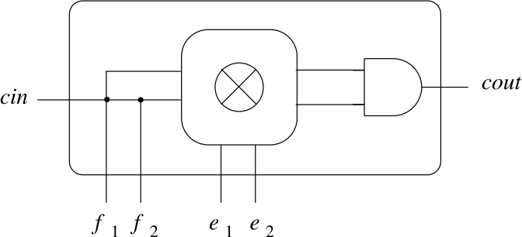
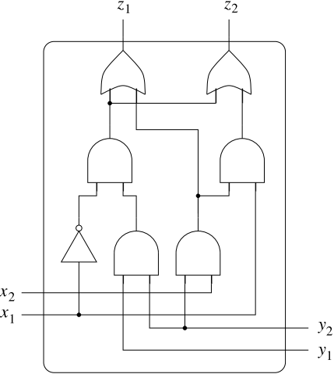
A Carry-Look-Ahead 4-Bit-Adder
RootCell
NodeCell
LeafCell
⊗ Circuit

Slide 71
Identities
In this reduction processes do not execute exactly the same code
The code makes use of the process identity (the index $i$) to organize processes in an array:
if $st\left[i\right]=q_{j}$ and $hd\left[i\right]=a$ then
$st\left[i+1\right]≔q_{k}$;
$hd\left[i\right]≔false$;
$hd\left[i+1\right]≔b$

